Slide 1
Yelp Restaurants Recommender
G76 DSI Capstone
Shijun Wang

Slide 2
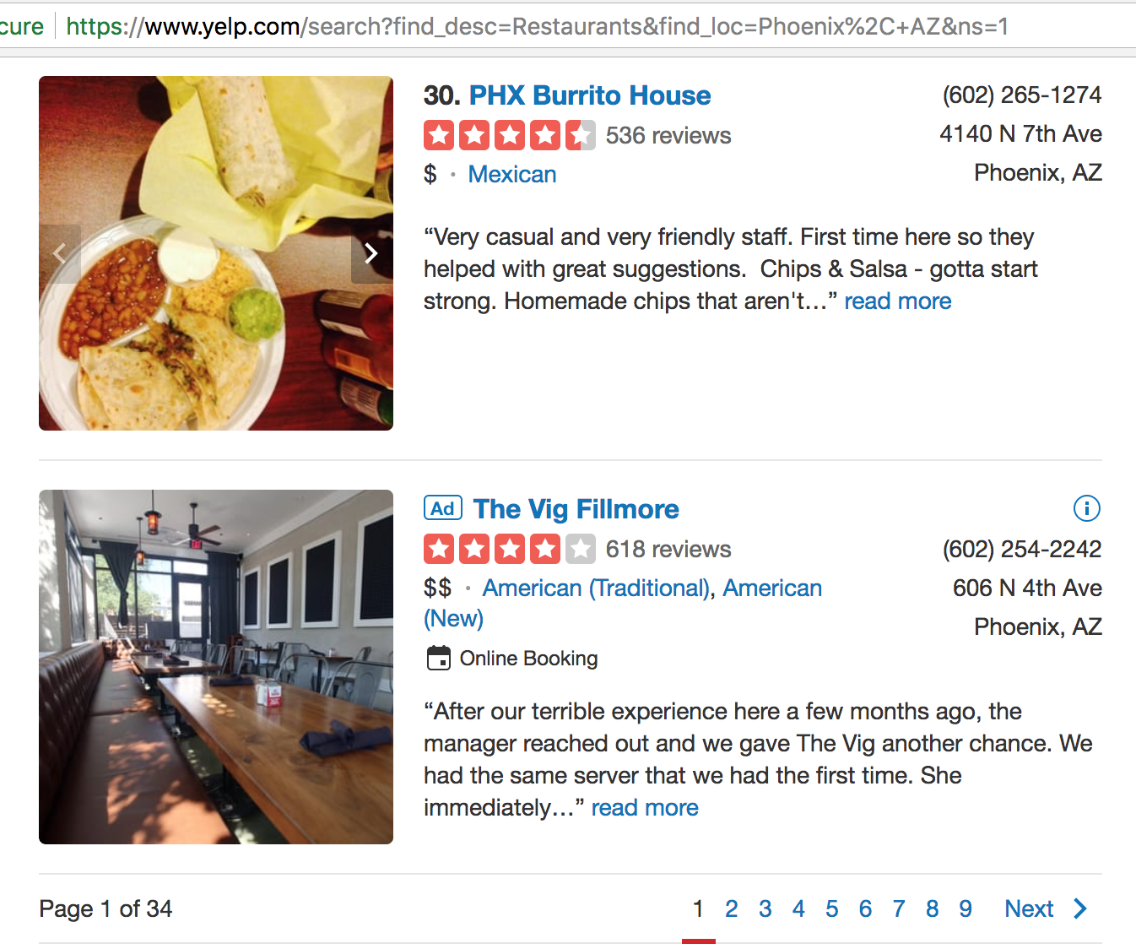
Why Not Search From Yelp Directly
Not personalized
Some restaurants the user likes may be in page 12...
Take some time to review through the content
Assumption
Restaurants reviewed by the user are the type of categories he/she likes to try
Limitation
Yelp API live data pull up to 1,000 restaurants for a given city to avoid connection error

Slide 3
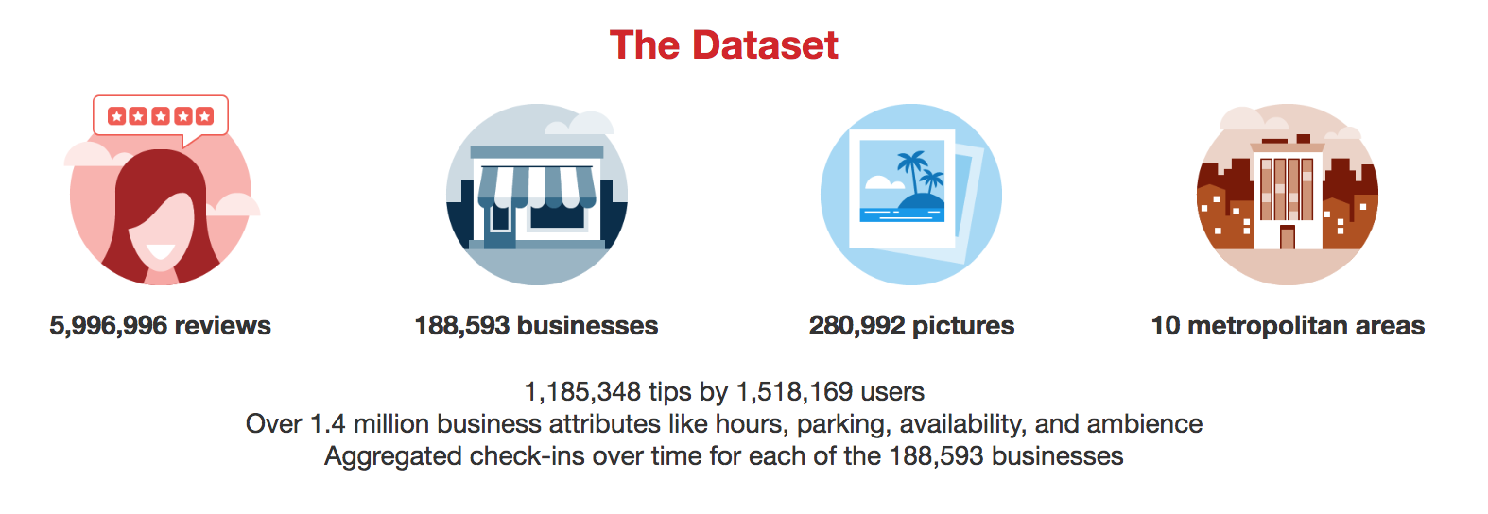
The Yelp Dataset
Yelp Dataset is from yelp challenge round 12 (accessed on 8/08/18)
https://www.yelp.com/dataset/challenge

Slide 4
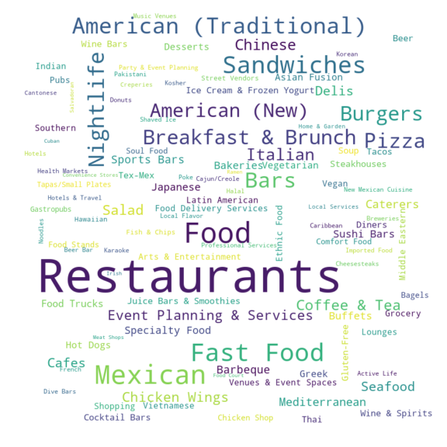
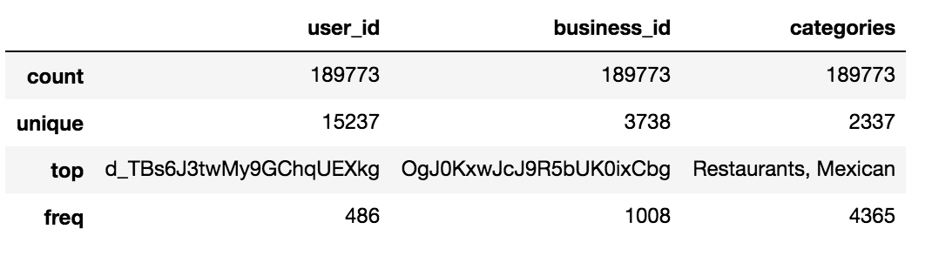
EDA
Sub Dataset stored in MongoDB:
Focus on restaurants in Phoenix
users with 5 or more reviews on those restaurants
Using restaurant categories:
categories unique value is more than 2,000
Split categories to key words
Word cloud
More than 300 unique words

Slide 5
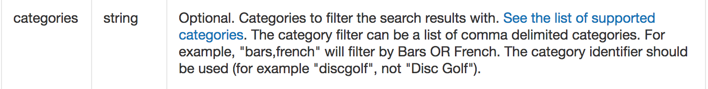
Challenge - Data structure inconsistent
Yelp MongoDB dataset restaurant categories is a string.
'Coffee & Tea, American (New), Breakfast & Brunch, Fast Food'
Yelp API live data restaurant categories is a list of dictionaries.
[{'alias': 'coffee', 'title': 'Coffee & Tea'},
{'alias': 'newamerican', 'title': 'American (New)'},
{'alias': 'breakfast_brunch', 'title': 'Breakfast & Brunch'},
{'alias': 'hotdogs', 'title': 'Fast Food'}]
Yelp API business search using parameters of categories:

Slide 6
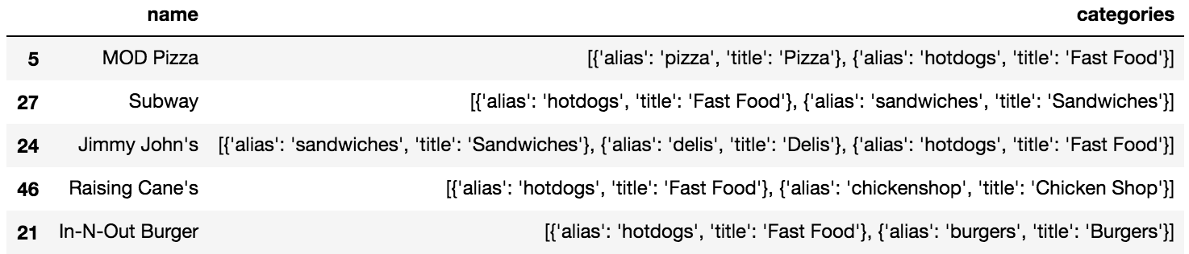
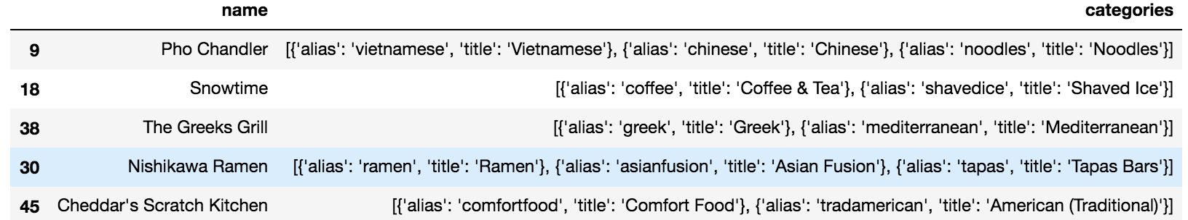
Yelp API Business Search
Search by Parameters {'categories': "hotdogs", 'location': 'Chandler'}
Search by Parameters {'categories': "Fast Food", 'location': 'Chandler'}

Slide 7
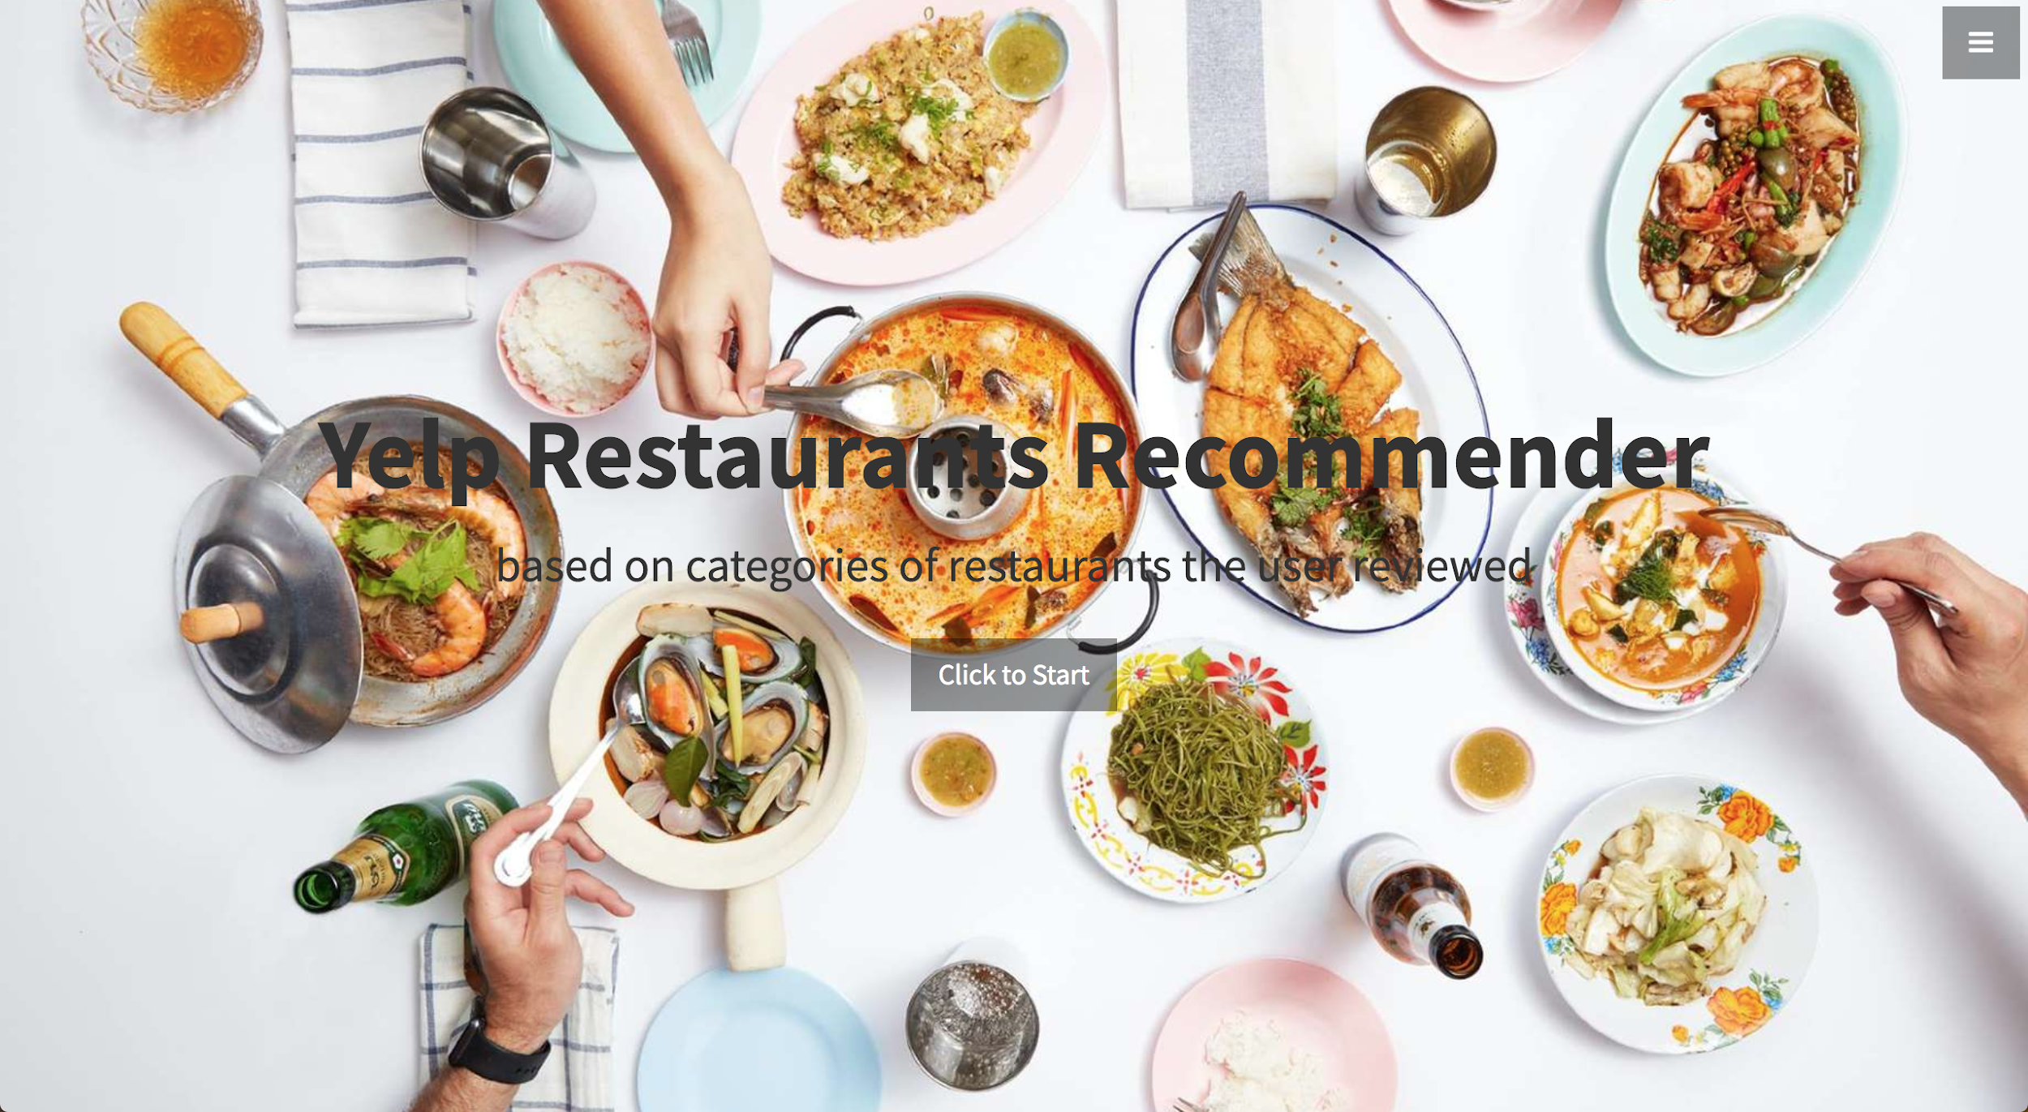
Web app by Flask - Starter page
AWS EC2 link
Some UserID to try:
--Nnm_506G_p8MxAOQna5w
--2HUmLkcNHZp0xw6AMBPg
-0IiMAZI2SsQ7VmyzJjokQ

Slide 8
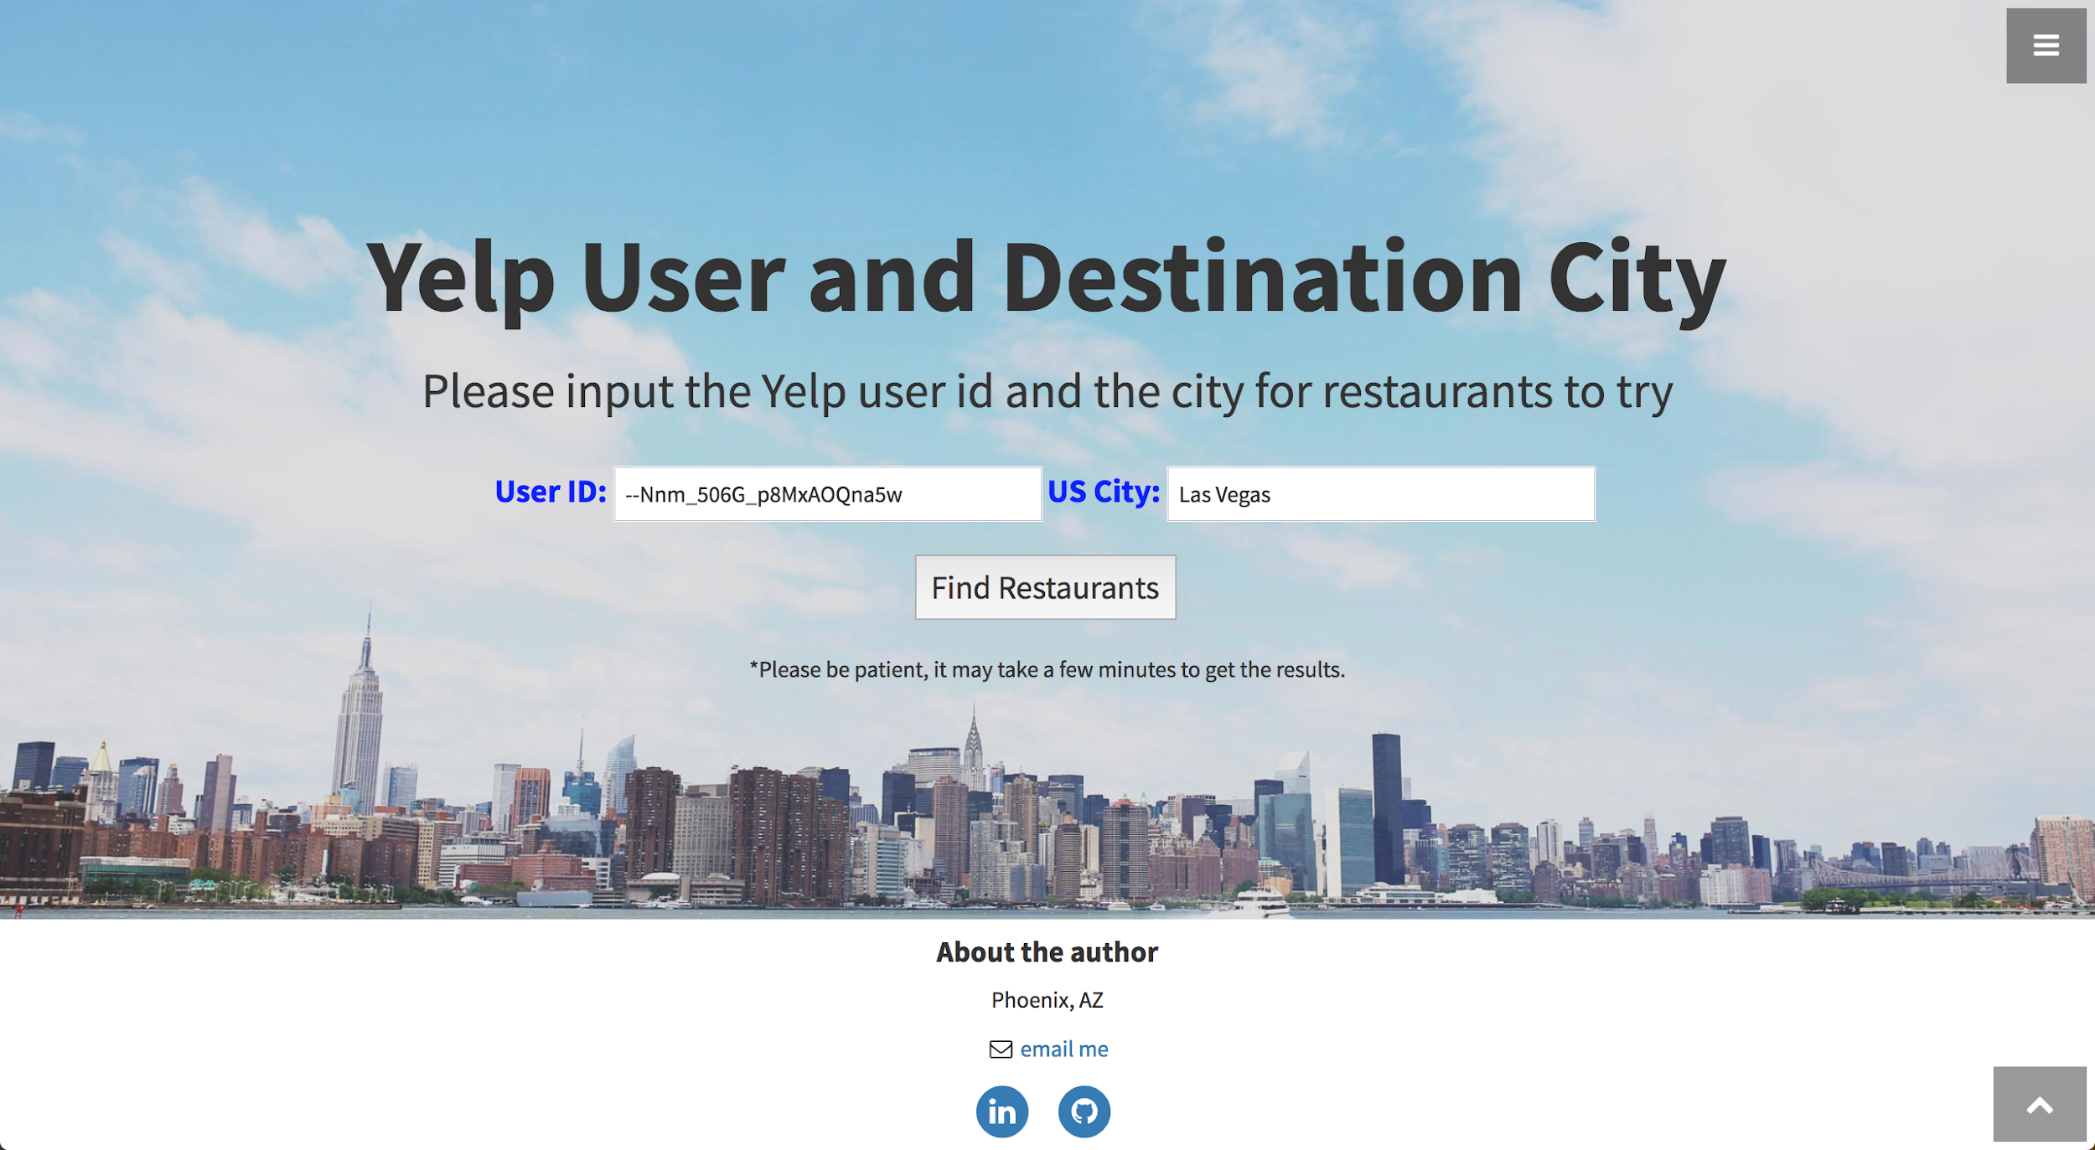
Input page
Using User ID to get local data from MongoDB, find most common words from categories of restaurants reviewed by this user.
Using Yelp API to retrieve live business data from Yelp for the given location.

Slide 9
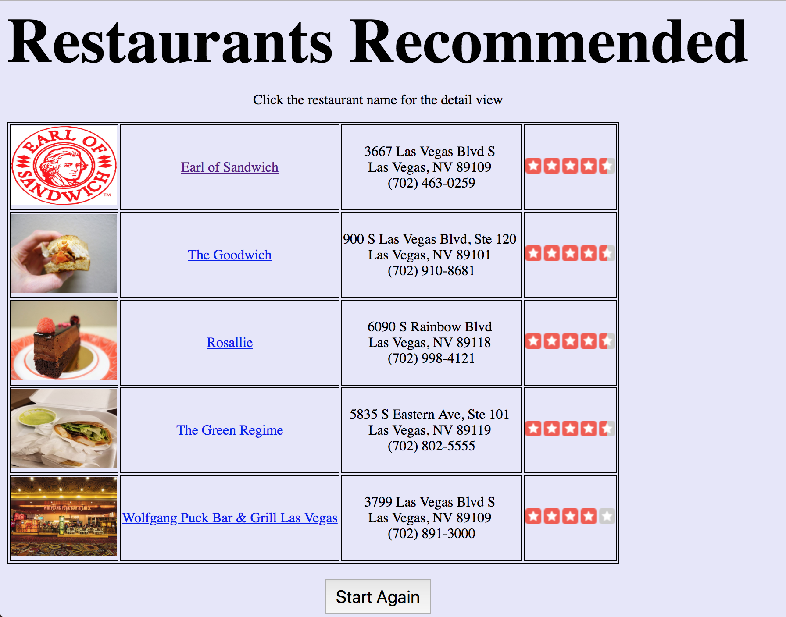
Recommender page
Return upto 5 restaurants (Yelp live data) whose categories contain the top 3 words from the categories of restaurants (MongDB) reviewed.
Typical image, name, address & phone #, overall rating stars
Click a restaurant name to open a new window for the detail view.

Slide 10










Tech Used

Slide 11

Questions?

